Slide 1
CS 231N Midterm Review

Slide 2

Midterm Logistics
Multiple Choice
True/False
Short Answer Questions
More emphasis on topics covered earlier in the course than those discussed more recently
Focus is more on high-level understanding of concepts
How many layers in a ResNet?
What problem does the ResNet solve and how?

Slide 3
More Logistics…
  The midterm exam will take place at 12:00 - 1:20pm PT on Tuesday, May 16 in person at NVIDIA Auditorium, 420-040, and Hewlett 200.
  If your last name begins with a letter between A and G (inclusive), you will take the exam at NVIDIA Auditorium.
  If your last name begins with a letter between H and M (inclusive), you will take the exam at 420-040.
  If your last name begins with a letter between N and Z (inclusive), you will take the exam at Hewlett 200.
  Closed-book, no internet. One double-sided cheat sheet (written or typed)
  The exam may cover material from Assignments 1 and 2 and all lectures up to and including Lecture 12 (Visualizing and Understanding).
  You will have 80 minutes to complete the exam. The exam will start immediately at 12:00pm. If you arrive late, you will not be given additional time.

Slide 4
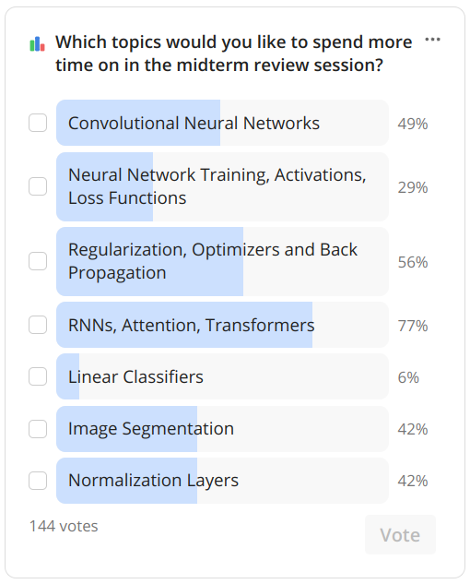
Midterm Review

Slide 5
Plan
Transformers & Attention
RNNs
Back Propagation
Optimizers
CNNs
Normalization Layers
Regularization Techniques

Slide 6
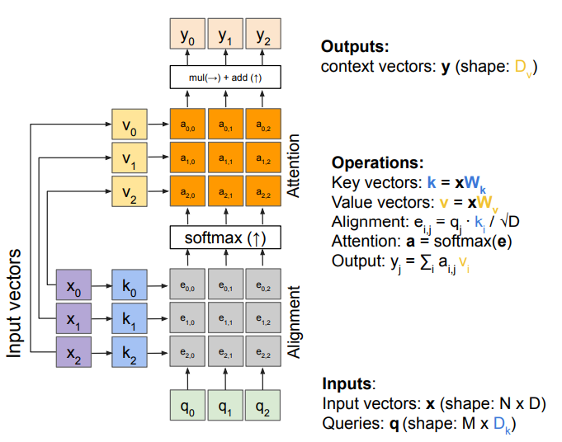
General Attention

Slide 7
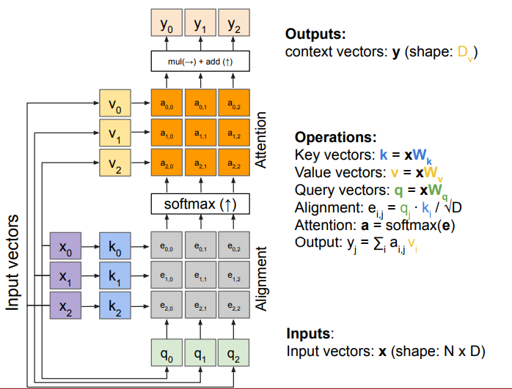
Self-Attention

Slide 8
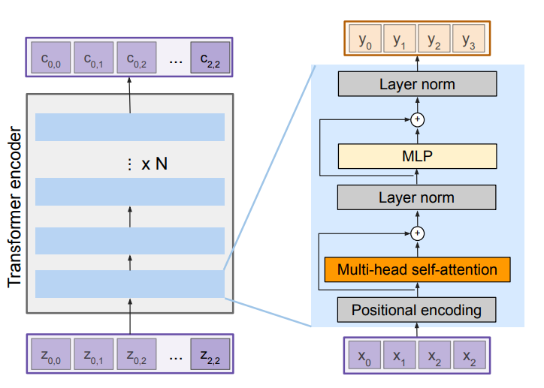
Transformer Encoder

Slide 9
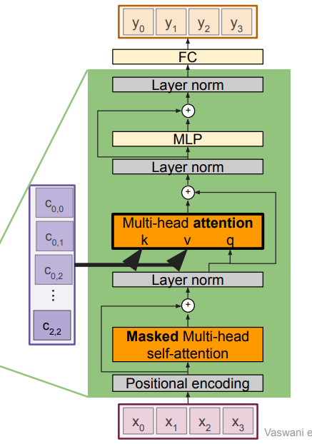
Transformer Decoder

Slide 10
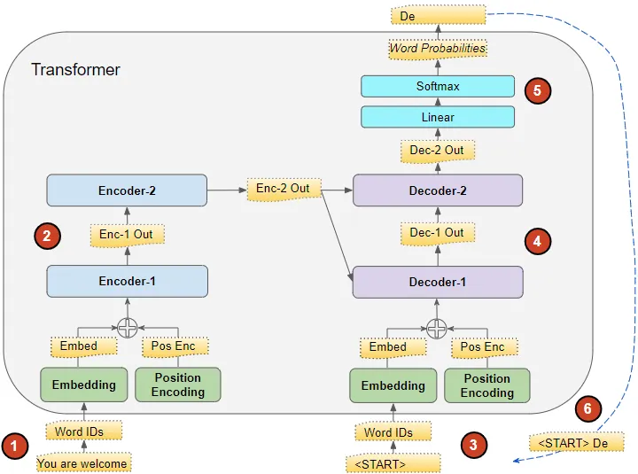
2 Layer Transformer Example
Credit: Medium article by Ketan Doshi

Slide 11
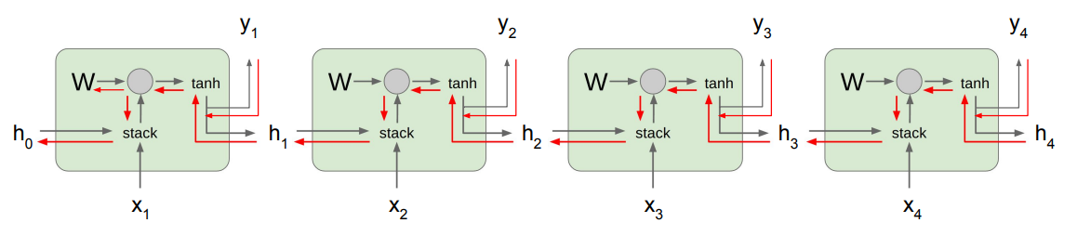
RNNs

Slide 12
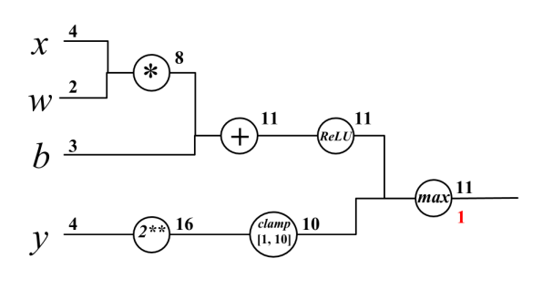
Backpropagation

Slide 13
Backpropagation
z
a
m
L
n
p

Slide 14
Backpropagation
z
2
a
m
1
4
L
1
1
1
n
p

Slide 15
Backpropagation
z
2
a
m
1
4
L
1
1
1
0
0
0
n
p

Slide 16
Optimizers
Optimizer | Per-Parameter Learning Rate | Momentum
SGD | No | No
SGD + Momentum | No | Yes
AdaGrad | Yes | No
RMSProp | Yes | No
Adam | Yes | Yes

Slide 17
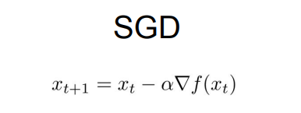
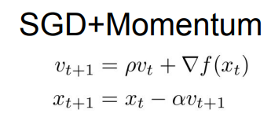
SGD

Slide 18
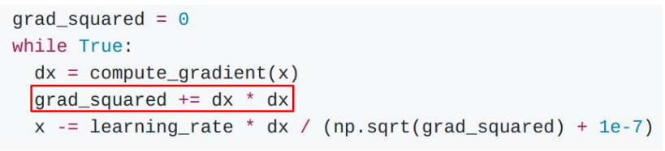
AdaGrad - Learning Rate Scaling (No momentum)

Slide 19
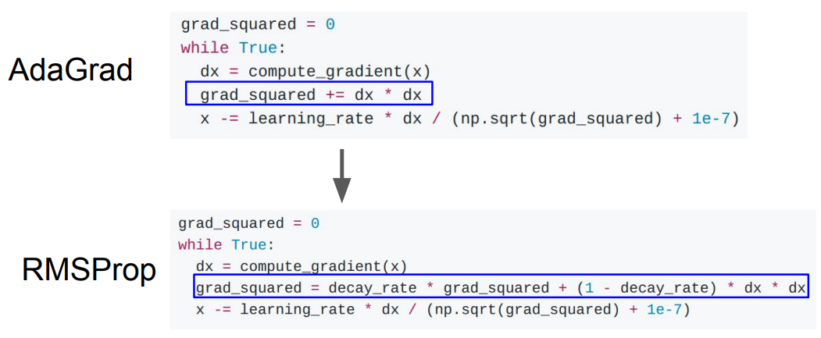
RMSProp - Slowing down scaling

Slide 20
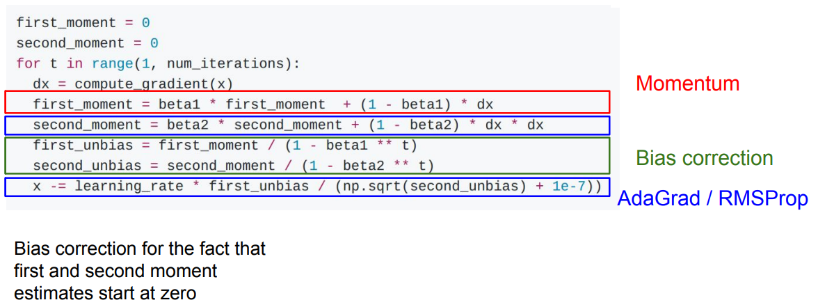
Adam - Momentum + RMSProp

Slide 21
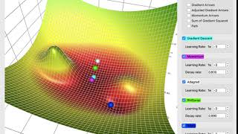
Visualization
Video: Lily Jiang

Slide 22
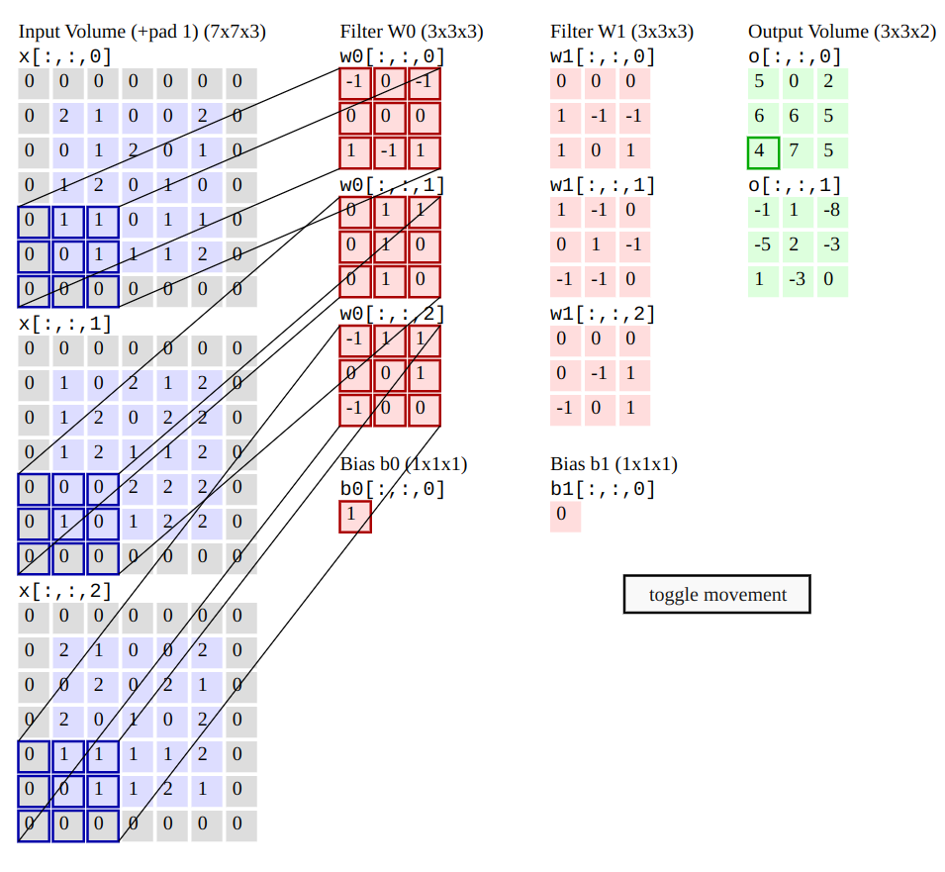
CNNs
Each filter has the same number of channels as the input image.
Each filter outputs just a one channel feature image.
Therefore, the total number of channels in the output vector is the same as the number of filters.

Slide 23
CNNs
The learnable parameters are the weights and biases.
Each filter has one bias, that is applied to all channels.
For an input image with C channels, N filters, each of size (FxF), the layer has N*(C*(F*F) + 1) learnable parameters

Slide 24
CNNs
Input Shape: (C,H,W)
User specifies: N filters, each of shape (FxF). Padding P, and Stride S
Output Shape:
(N, H’, W’)
W’=(W−F+2P)/S+1
H’=(H−F+2P)/S+1
Note: Image on the left has Stride=2

Slide 25
BatchNorm vs LayerNorm
BatchNorm: Normalize across all data-points in the batch
LayerNorm: Normalize across the features of each data-point
Input shape: (N, D)
BatchNorm: Normalizes across N
LayerNorm: Normalizes across D

Slide 26
BatchNorm vs LayerNorm
BatchNorm: Normalize across all data-points in the batch
LayerNorm: Normalize across the features of each data-point
Input shape: (N, C, H, W)
BatchNorm: Normalizes across N*H*W
(calculates mean and var for each channel, across all images in the batch)
LayerNorm: Normalizes across C*H*W (calculates mean and var for each image, across all pixels in all channels)

Slide 27
BatchNorm vs LayerNorm
Input shape: (N, C, H, W)
BatchNorm: Normalizes across N*H*W
(calculates mean and var for each channel, across all images in the batch)
LayerNorm: Normalizes across C*H*W (calculates mean and var for each image, across all channels)
What is the size of their learnable parameters?

Slide 28
BatchNorm vs LayerNorm
Input shape: (N, C, H, W)
BatchNorm: Normalizes across N*H*W (reshape (N*H*W, C))
(calculates mean and var for each channel, across all images in the batch)
LayerNorm: Normalizes across C*H*W (reshape (N, C*H*W))
(calculates mean and var for each image, across all channels)
What is the size of their learnable parameters?
BatchNorm: C
LayerNorm: (C*H*W)

Slide 29
BatchNorm vs LayerNorm
One important difference:
BatchNorm calculates the mean and var across the batch, and stores a running average which is used during test
LayerNorm performs the same during test and train

Slide 30
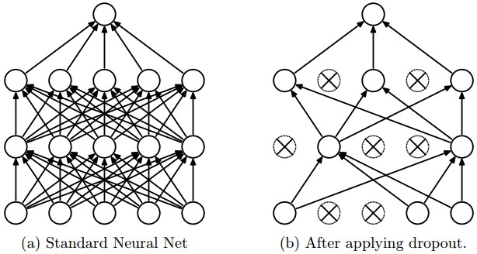
Regularization / Training a Neural Network
L1 and L2 Regularization penalize the size of weights
Dropout adds redundancies to learned parameters

